Slide 1
LIBS 7001 Wk 9 - MECH
Logos and Fallacies
review course activities to term end
define induction and deduction and their uses
define syllogism, enthymeme and their parts
analyze essays using logical appeal; discussion:
  "Beating the Drum: Canadian Print Media and the Build-Up to the Invasion of Iraq” by Tareq Ismael – seminar by Kevin
  selections from The Prince by Machiavelli – seminars by Jacky and Mat
As a start: identify main argumentative fallacies
Next class: Pathos and Psychological Motivation
  readings and questions noted in syllabus, including “Funeral Speech for Diana, Princess of Wales” and “An Insatiable Emptiness”

Slide 2
To Ponder for Next Week
from T. Kane, “Persuasion: Non-Rational Modes:”
“Unlike argument, emotive persuasion poses a moral problem. It can be used more easily than argument to move us against our will, and even, perhaps, counter to it” (Kane, 501). Be prepared to discuss this, giving a few examples.
“To assume that advertisements and press releases and political claims are all lies is no wiser than taking them at face value” (Kane, 502). Do you agree or disagree? Discuss.

Slide 3
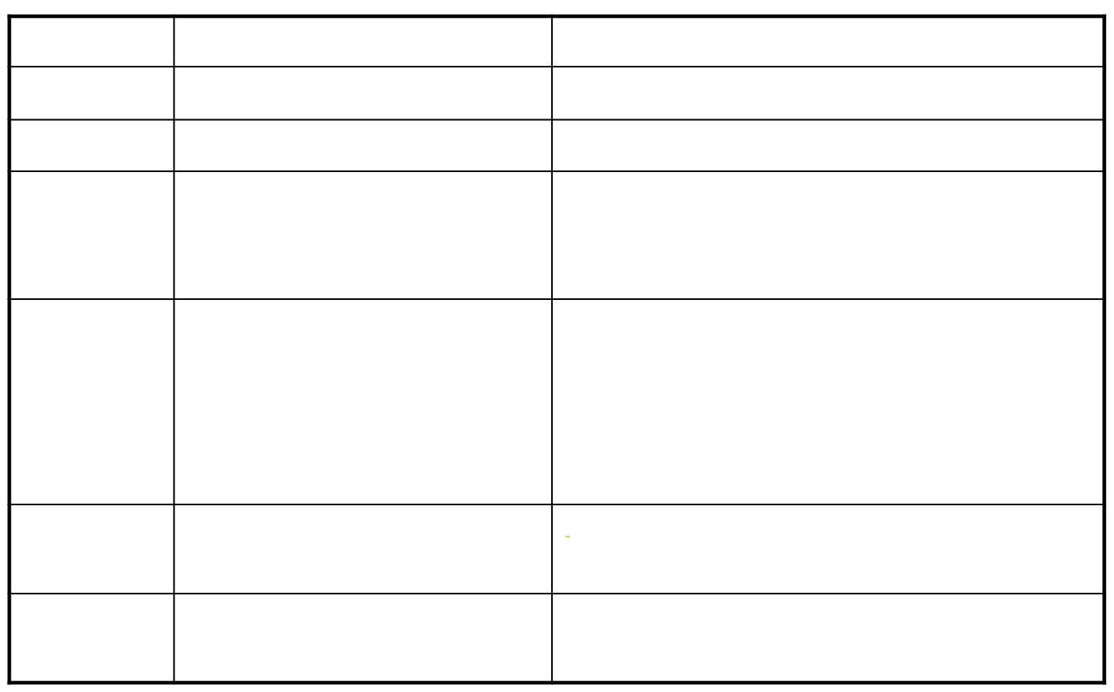
Class activities to end of term

Slide 4

Review of Argumentative Appeals

Slide 5
Support Rational Appeals with
Primary sources
  those directly involved in the issue
  interviews, surveys, etc.
Secondary sources (NOT tertiary)
  those commenting on the issue
  make sure your sources are authoritative
Statistical data
  beware of bias
  choose reliable, recent data
  avoid misuse

Slide 6
Supporting a Rational Appeal
Authorities’ opinions
  cite source & avoid bias
Established truths
  facts no one can seriously dispute
  use as back-up, not main evidence.
Personal experience
  use to reinforce other evidence, not main evidence
Syllogistic logic
  using a standard pattern of reasoning that links assertions and evidence

Slide 7
Logical Proof in Reasoning
(Crowley, pp. 158-185)
Aristotle’s 4 “logical methods” or “ways of reasoning:”
  scientific demonstration
  dialectic
  rhetoric
  false or contentious reasoning
Each begins with a “premise,” “any statement laid down, supposed, or assumed before the argument begins” (159)

Slide 8
Using premises (p. 159)
Premises are combined with other premises to reach conclusions
Arguers ensure their arguments are valid (correctly reasoned) by observing formal rules of arranging the premises.
Conclusions reached by these means are true only if the premises are true.

Slide 9
Premises & 4 reasoning types
Scientific demonstration: argument must begin from premises that are true or that experts accept as true
  The earth orbits the sun.
Dialectical reasoning: arguers are less certain but begin from premises accepted by people considered wise.
  The unexamined life is not worth living.

Slide 10
Premises & types of reasoning
Rhetorical reasoning: premises are believed true by most of the community
  Convicted criminals should be punished.
False or contentious reasoning: premises only appear to be widely accepted, or premises are false.
  New Democrats always raise taxes when they get elected
  Everyone knows that white people are inferior to black people

Slide 11
Premises & types of reasoning
The difference among the four types
  has nothing to do with exterior criterion for truth
  depends upon degree of belief awarded to premises by those arguing
Is certainty of statements relative?
  Yes, but probability can be posited because “human behavior in general is predictable to some extent” (p. 160)

Slide 12
Probability, cont.
argument from probability (rhetorical) - articulates common sense about human behaviour: e.g.,
      A small, weak person will not physically attack a large strong person
Quintilian’s 3 sorts of probability statements
  those involving what usually happens
      Parents usually love their children.
  those that are highly likely
      Someone who’s healthy today will be alive tomorrow.
  those in which nothing works against their probability
      A household theft was committed by some resident of the household.

Slide 13
Enthymemes
in the common (not strict Aristotelian) sense - an informal argument from which one premise has been omitted.
you must provide the unstated premise, in order to check the argument for validity
  Joe spends his social assistance check on booze; all welfare recipients cheat.
  Men have the power in Hollywood. That’s why there’s so few good roles for female actresses.

Slide 14
Analyzing Enthymemes
(1-2 from EJ Corbett; 3 from SSW)
He must be happy because he’s smiling all the time.
Since the bullet obviously entered through his back, we have to rule out suicide; quite certainly he was murdered.
Bill really loves to eat. Clearly, he’ll have a serious weight problem someday.

Slide 15
Enthymemes & their power
“enthymeme of evil” (Smith, cited by Crowley, p. 168-169), used by GW Bush in wake of 9/11
“carefully constructed so it was ambiguous, allowing room for a host of premises” (170)
“Enthymemes are powerful because they are based in community beliefs.” (170)
rhetorical premises: major premise is likely to be “a probability rather than a certainty, and thus exceptions to it do exist” (171)

Slide 16
Rhetorical examples (Crowley, p. 172 ff)
not the same as “instances” used in induction
used not in reasoning from particular to general but from part to part
can vividly evoke memories in audience
can be
  historical (cases)
  fictional (e.g., fables)
  analogical / hypothetical (comparative)
related: argument from sign (p. 184)
also consider & avoid misuse of maxims (182 ff.)

Slide 17
Two Approaches to Argument
Induction: “the progress from the particular to universals” (Aristotle, in Crowley, p. 165)
  If a skilled pilot is the best pilot and if a skilled charioteer is the best charioteer, then the skilled person is the best person in any particular sphere.
Deduction: begins with a generally accepted observation, then shows how certain conclusions follow from that observation
  Ghosts and vampires are immortal creatures. Casper and Dracula are a ghost and a vampire. Casper and Dracula are immortal creatures. (Crowley, p. 164)

Slide 18
More on Induction
Maxine Hairston, A Contemporary Rhetoric. 1978, Ch. 9; Crowley, p. 165
“particulars” on which an inductive argument is based are also called “instances” or “examples” (Crowley, 165)
examples of use: decisions made based on market research, polling
use when audience may resist your argument
move from question &/or specific instances, to stating your position
must choose sufficient, random, accurate, and relevant evidence, and avoid bias
opposite is deduction (general to specific)

Slide 19
Deduction & Syllogisms
Deduction is the most common type of logical appeal; used in mathematics, business, physical & applied sciences
moves from a general truth through particular evidence and details, to a conclusion
often based around a syllogism, a set of three statements made about classes of things, following a fixed pattern to ensure sound reasoning.
In rhetoric (Crowley, 164) definitions of classes in syllogisms aren’t completely enumerated, since the aim is to be persuasive, not scientifically accurate

Slide 20
Categorical Syllogism Parts
  major premise All men are mortal.
  minor premise Socrates is a man.
  conclusion Therefore, Socrates is mortal
major premise: names a category of things and says that all or none of them share a certain characteristic
minor premise: notes that a thing or group belongs to that category
conclusion: states that the thing or group shares the characteristics of the category.
Both premises must be true, to produce a logical conclusion.

Slide 21
Avoiding Syllogism Misuse
Make sure your premises are in fact true: e.g., “All West Vancouverites are wealthy” is untrue.
Make sure your syllogisms keep the terms in the proper order and relationship. Invalid:
  All persons are mortal
  Sue is mortal
  Therefore, Sue is a person.
Optional: you can memorize rules for syllogisms, or use diagrams

Slide 22
Which of these syllogism is satisfactory, which have false major premises, and which is faulty because the last two statements are reversed? *
All singers are happy people. (Major Premise)
Mary Harper is a singer. (Minor Premise)
Therefore, Mary Harper is a happy person. (Conclusion)
All cowards fear danger.
"Chicken" Cacciatore is a coward.
Therefore, "Chicken" Cacciatore fears danger.
* from SSW, p. 318

Slide 23
Syllogism practice, cont.
All cats like meat.
Towser likes meat.
Therefore, Towser is a cat.
No salesperson would ever misrepresent a product to a customer.
Sabrina is a salesperson.
Therefore, Sabrina would never misrepresent a product to a customer.
SSW, p. 318

Slide 24
Diagramming Syllogisms
- All persons are mortal.
- Sue is mortal.
- Therefore, Sue is a person.
mortals
persons
Sue
-invalid argument / undistri-buted middle term (“persons”): Sue could be a mortal creature other than a person (e.g., a cat, penguin).
You can diagram the syllogisms to test validity.

Slide 25
Diagramming Syllogisms, cont.
- All persons are mortal.
- Sue is a person.
- Therefore, Sue is mortal.
mortal
Sue
-valid argument
persons

Slide 26
Argumentative Fallacies adapted from Reinking, Horner, Kane;" Stephen's Guide to the Logical Fallacies,” http://onegoodmove.org/fallacy/
Testing arguments can help reveal fallacies, or errors in reasoning. Types and foci if fallacies:
  Material Fallacies: focus on the truth of the premises, & the material on which the conclusion is built
  Logical Fallacies: focus on the validity of the chain of reasoning
  Psychological / Emotional Fallacies: lead to faulty reasoning by clouding the issue
NOTE (updated from lecture): this is ONE way to categorize fallacies, based on Horner; see “Stephen’s Guide” for another system of classification

Slide 27
1. Material Fallacies
Faulty Generalization: a broad, unsupported statement about a class of people or things.
  He graduated from university, so he must be smart
  Men can never ask for directions when they're lost
Insufficient Sampling: generalizing from a small sample of evidence:
  I'll never buy fruit at that store again; this banana is rotten.

Slide 28
1. Material Fallacies, continued
Unrepresentative Sampling: generalizing from a biased sample
  [polling only environmentalists about using pesticides, or Fraser Institute members about results of tax cuts]
Card-Stacking: deliberately selecting only the evidence that supports your position
  Students have an easy life -- they get to sit in a classroom all day long and read lots of books.
  Saddam executes the wives of people disloyal to his regime; why isn’t Canada joining the U.S. to fight against Saddam? (? period in Can. parliament, March 26/03)

Slide 29
2. Logical Fallacies
Faulty Cause (post hoc, ergo propter hoc): asserting that because one thing happened before the other, the first caused the second
  It’s raining because I washed my car.
  He got his job because he graduated from UBC.
False Alternatives (Either/Or): presenting only two of many alternatives
  You’re either with us or with the terrorists.
  We either make these cuts or face a continued crisis in the BC economy.

Slide 30
2. Logical Fallacies, cont.
Rigged Question, arranged so that all direct answers support the questioner’s position
  Have you stopped cheating on exams? (yes or no)
  If we don’t raise tuition fees, which hospital would you like us to close?
  When will you stop drinking and driving? (CounterAttack ad)
Arguing off the Point / Avoiding the Question: evasive tactic - breaks the chain of reasoning
  Q: Was this a terrorist attack? A: All the resources of the NTSB and FAA will be used in the investigation.

Slide 31
2. Logical Fallacies, cont.
Equivocation: using word-play to confuse meaning
  Liz's religion is Buddhism, but Sean's religion is hockey.
  The sign said "fine for parking here,” and since it was fine, I parked there. [ from S. Downes]
Non Sequitor (“it does not follow”): two ideas not logically connected
  Pav's been out every night this week; what’s the name of the club?

Slide 32
2. Logical Fallacies, cont.
Begging the Question: determining response by the way the question is worded
  You can’t give a promotion to this corrupt manager.
  We were elected to bring order to BC’s chaotic finances.
Circular Argument: “first cousin” to begging the question; restates the assertion without evidence
  Pauline’s a good manager because she runs the company effectively.
  Some people are just looking for trouble. Trouble’s easy to find when you’re looking for it (P. Hearst to L. King, 01/26/020.)

Slide 33
3. Psychological Fallacies
Ad Hominem: attacking the person, not the argument
  He’s so weird looking! How can you trust his ideas on the economy?
Guilt by Association: Her brother’s a loser so she must be one, too.
Argument to the Club: appeal to force - subtle or direct
  I’ll make you an offer you can’t refuse. (The Godfather)
  You’d better go along with the new company policy or you might lose your job [from S. Downes]

Slide 34
3. Psychological Fallacies, cont.
Bandwagon: pressure to conform to supposed group values
  Everyone thinks that this course is too hard.
  But all my friends are going -- why can't I?
Name-Calling: emotional form of faulty generalization +
  Belly-aching teachers should take a stab at the real world. (headline for letter to editor, Van. Sun, Oct. 6, 2005)
Glittering Generalities: opposite of name-calling; motherhood; faith in God;
  Our brave troops who fight for freedom….

Slide 35
3. Psychological Fallacies, cont.
Fallacy of the golden past: suggests that things have deteriorated over time & looks back to a idealized, unlocalized “past”
  Kids today have no respect for their elders
  “When I was young….”
  Things were better in the old days (1990s? 1890s?)
Fallacy of progress: suggests a movement forward in time towards some transcendent “future”
  Things keep getting better every day in every way…
  More computer use makes things more efficient…
  The future is friendly (Telus slogan)

Slide 36
3. Psychological Fallacies, cont.
Appeal to Ceremony or Setting
  [doctors, police, scientists, etc. in uniforms]
  [someone appearing devout at temple or church]
  To be the boss, dress and act like the boss.
Appeal to Authority (faulty or otherwise)
  This Nobel-prize-winning researcher recommends….
  Mr. T says: Buy the Flavor-Wave Oven!
Appeal to Tradition
  We've always done it this way.
Appeal to Ignorance / Failure to Find Proof
  Can you prove God exists? Then, God doesn't exist.

Slide 37
3. Psychological Fallacies, cont.
Appeal to Humour: deflects attention from logic
  Do you descend from apes on your mother's or father's side? (+ rigged question)
Appeal to Pity
  Your honour, my client has 5 young children & a sick wife.
  [appeal for an extension on a project] The computer crashed and I lost all my work.
  We hope you'll accept our recommendations. We spent the last three months working extra time on it. [S. Downes]

Slide 38
3. Psychological Fallacies, cont.
Argument to the person: appeal to audience’s personal bias, ignoring other claims
  A tax cut will put more money in your pocket.
Appeal to the crowd: suggests deference to the supposed wisdom of the audience
  We all know that freedom is under attack.
Faulty Analogy: links two things / persons that may not be enough alike
  Just as nails must be hit in the head in order to make them work, so must employees. [S. Downes]
  Government should be run like a business
See Thomas Kane, “Persuasion: Nonrational Modes” for more examples of fallacies - to be discussed next wk.

Slide 39
Discussion Questions (Ismael / Machiavelli)
After you determine the audience, purpose and thesis of each text, answer the following questions:
Identify 2-3 specific arguments (positions the author takes) that can be conceded or refuted.
What kind(s) of evidence does the author provide?
What counter-arguments are presented? How does the author refute them?
Identify a place at which the author effectively uses enthymemes, examples, deduction
Does the text contain fallacies? If, so, identify and explain them.
Are you convinced by the arguments? Why or why not?
How can you relate the author's ideas to your own life or to a contemporary context?

